Slide 1
Kalman Filter Examples (by the numbers)
Prof. Michalson

Slide 2
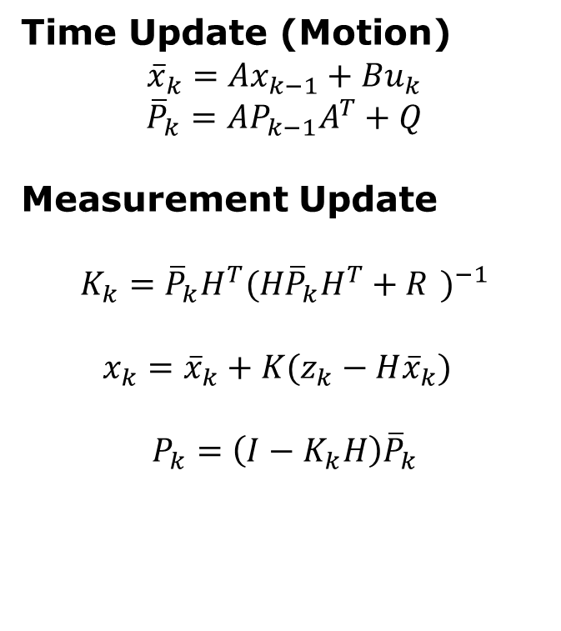
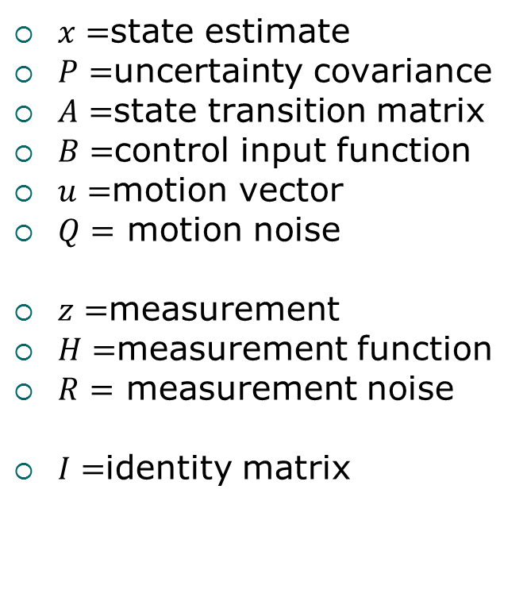
Kalman Filter at a Glance
$x=$state estimate
$P=$uncertainty covariance
$A=$state transition matrix
$B=$control input function
$u=$motion vector
$Q=$ motion noise
$z=$measurement
$H=$measurement function
$R=$ measurement noise
$I=$identity matrix
Time Update (Motion)
$${\overline{x}}_{k}=Ax_{k−1}+Bu_{k}$$
$${\overline{P}}_{k}=AP_{k−1}A^{T}+Q$$
Measurement Update
$$K_{k}={\overline{P}}_{k}H^{T}{(H{\overline{P}}_{k}H^{T}+R )}^{−1}$$
$$x_{k}={\overline{x}}_{k}+K(z_{k}−H{\overline{x}}_{k})$$
$$P_{k}=\left(I−K_{k}H\right){\overline{P}}_{k}$$

Slide 3
Building a Kalman Filter
The Kalman Filter relies on an adequate model of the system. When approaching filter design:
Understand your problem – what are the important dynamics to model?
Create a state transition model – Start simple!
Create a measurement model – How do measurements indicate state?
Create a noise model – Basic equations assume white noise.
Test the filter – Evaluate performance.
Refine – Tune noise parameters or state/measurement models.

Slide 4
Estimating Position from a Wall
Step 1 – Understand the Problem:
Consider one-dimensional problem with a robot using a laser to measure distance from a wall.
The robot can be stationary, is moving towards, or is moving away from the wall.
There is noise in the sensor that will result in changes in the range measurement even if the robot is stationary.

Slide 5
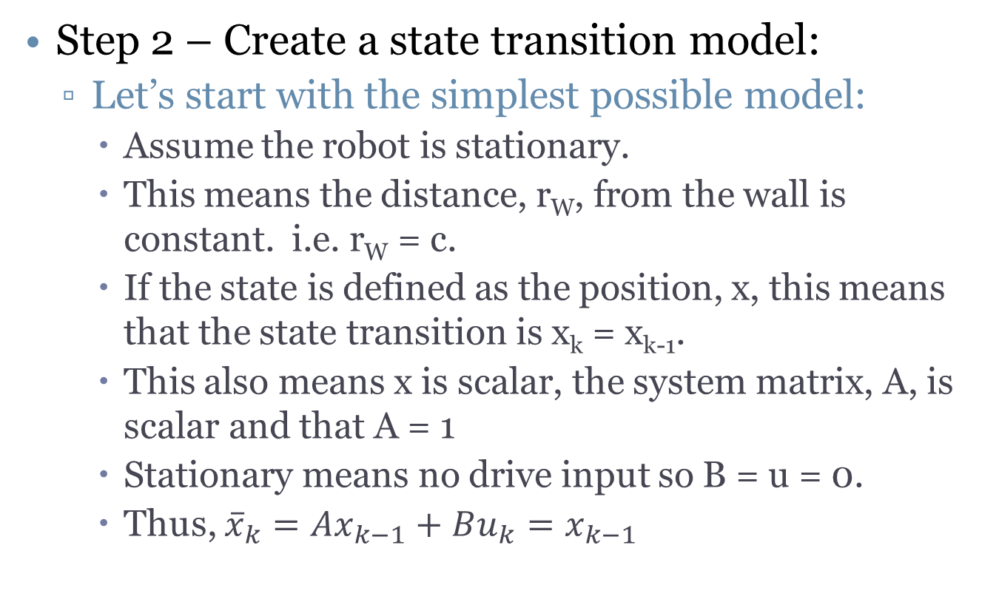
Estimating Position from a Wall
Step 2 – Create a state transition model:
Let’s start with the simplest possible model:
Assume the robot is stationary.
This means the distance, r_{W}, from the wall is constant. i.e. r_{W} = c.
If the state is defined as the position, x, this means that the state transition is x_{k} = x_{k-1}.
This also means x is scalar, the system matrix, A, is scalar and that A = 1
Stationary means no drive input so B = u = 0.
Thus, ${\overline{x}}_{k}=Ax_{k−1}+Bu_{k}=x_{k−1}$

Slide 6
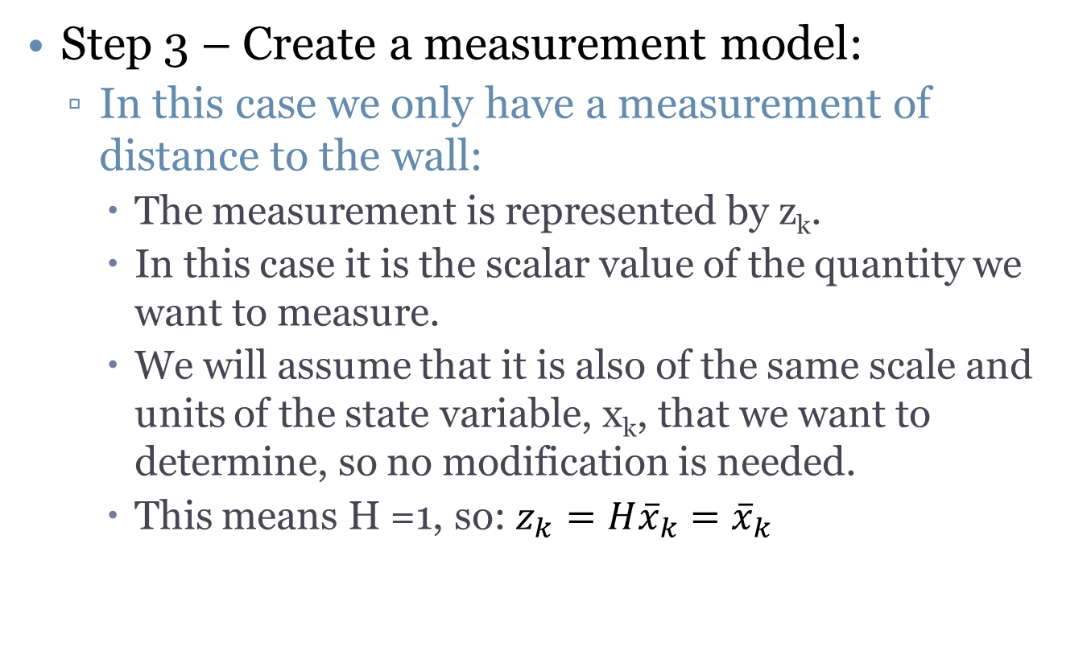
Estimating Position from a Wall
Step 3 – Create a measurement model:
In this case we only have a measurement of distance to the wall:
The measurement is represented by z_{k}.
In this case it is the scalar value of the quantity we want to measure.
We will assume that it is also of the same scale and units of the state variable, x_{k}, that we want to determine, so no modification is needed.
This means H =1, so: $z_{k}=H{\overline{x}}_{k}={\overline{x}}_{k}$

Slide 7
Estimating Position from a Wall
Step 4 – Create a noise model:
Assume that the laser range finder provides a noisy measurement:
The measurement noise has variance R, which is a scalar value.
The process noise will also be a scalar value, Q, which is generally not available.
Since the problem is scalar, the noise error covariance, P, is also a scalar.

Slide 8
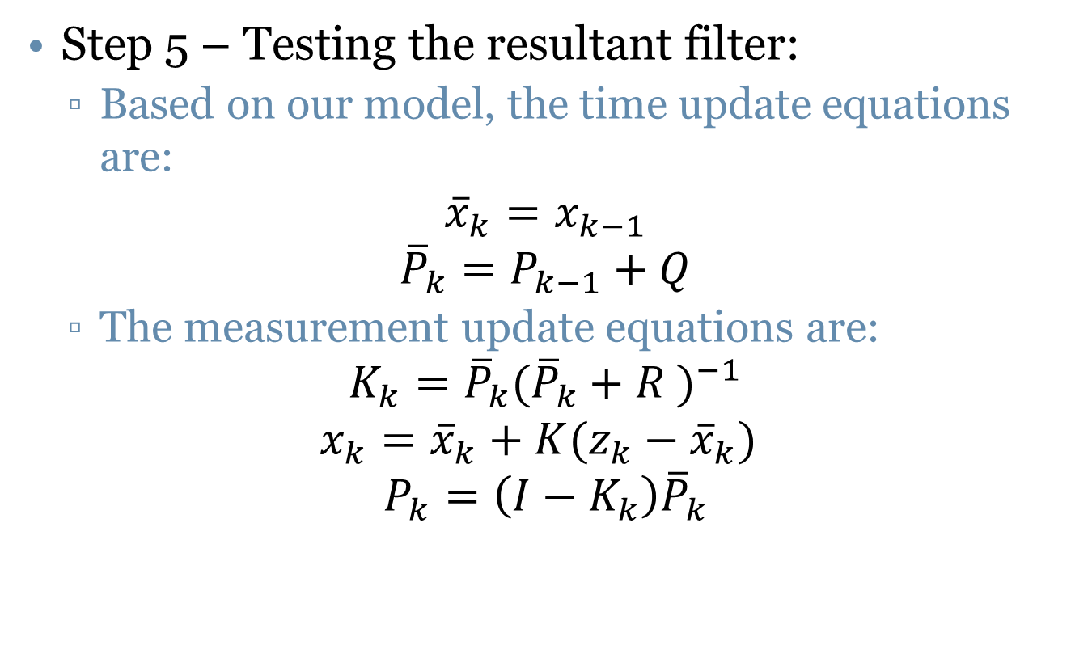
Estimating Position from a Wall
Step 5 – Testing the resultant filter:
Based on our model, the time update equations are:
$${\overline{x}}_{k}=x_{k−1}$$
$${\overline{P}}_{k}=P_{k−1}+Q$$
The measurement update equations are:
$$K_{k}={\overline{P}}_{k}{({\overline{P}}_{k}+R )}^{−1}$$
$$x_{k}={\overline{x}}_{k}+K(z_{k}−{\overline{x}}_{k})$$
$$P_{k}=\left(I−K_{k}\right){\overline{P}}_{k}$$

Slide 9
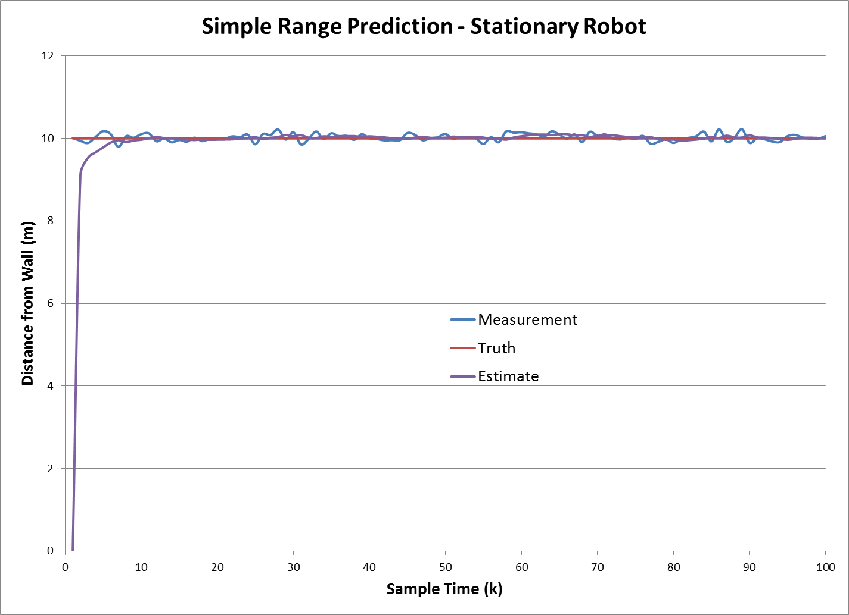
Simple Filter Performance

Slide 10
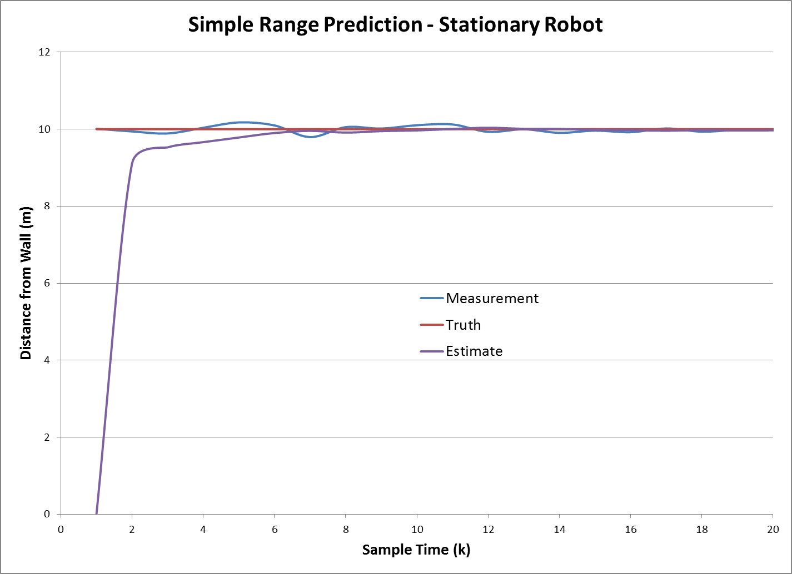
Simple Filter Performance - Closeup

Slide 11
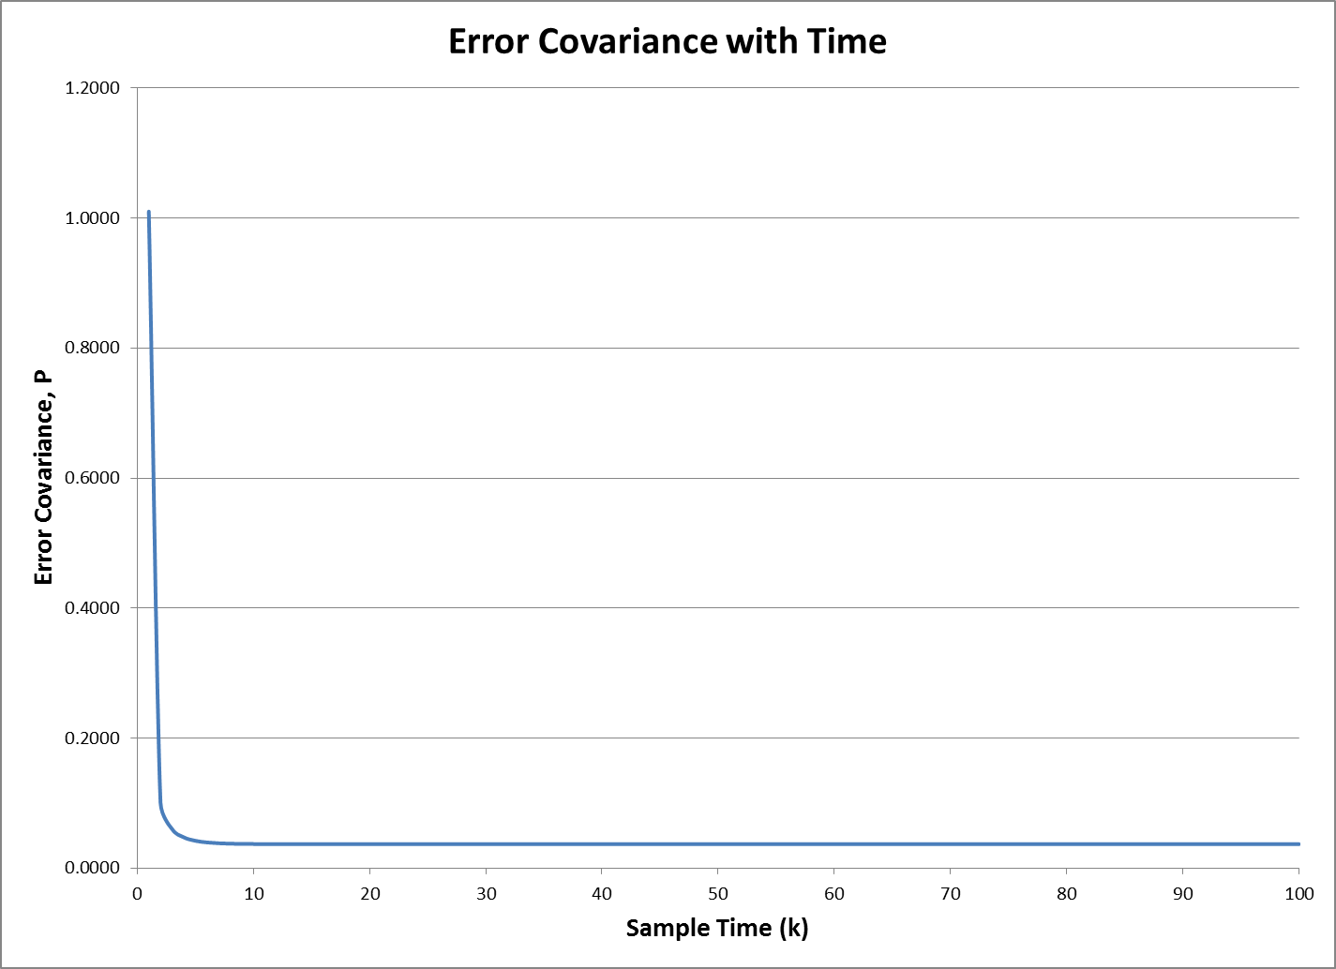
Convergence of Error Variance

Slide 12
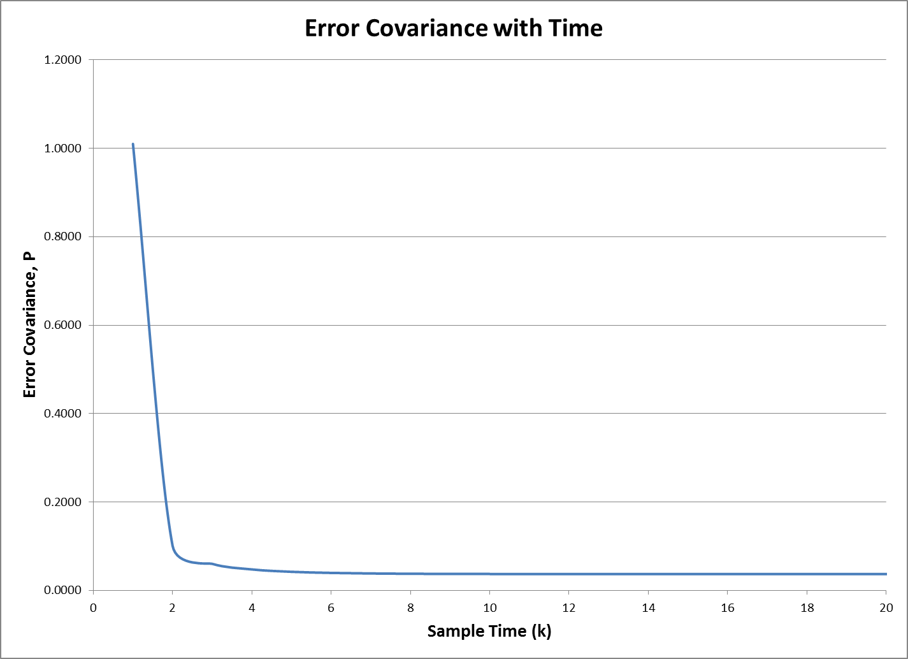
Convergence of Error Variance - Close-up

Slide 13
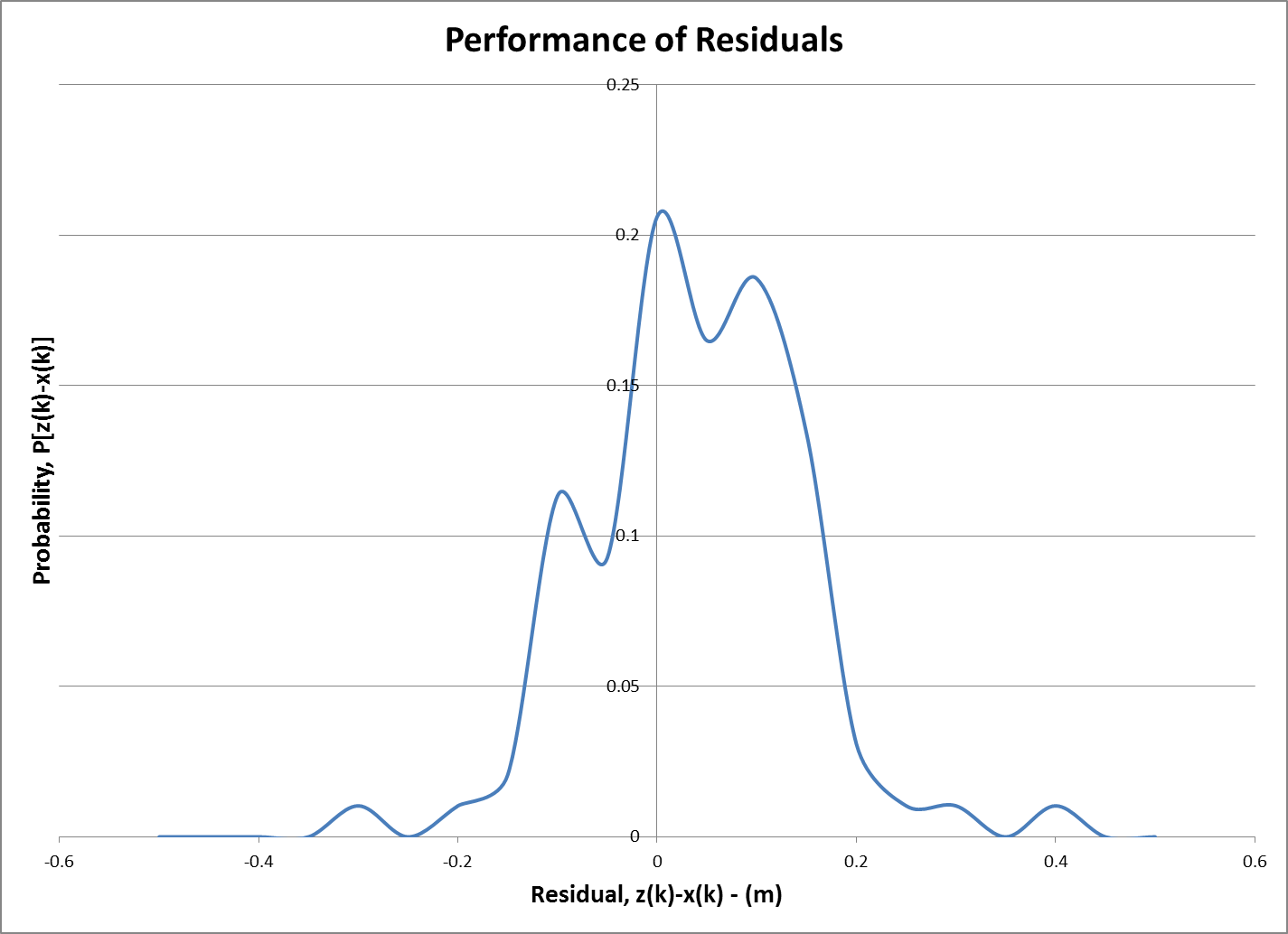
Residual Behavior

Slide 14
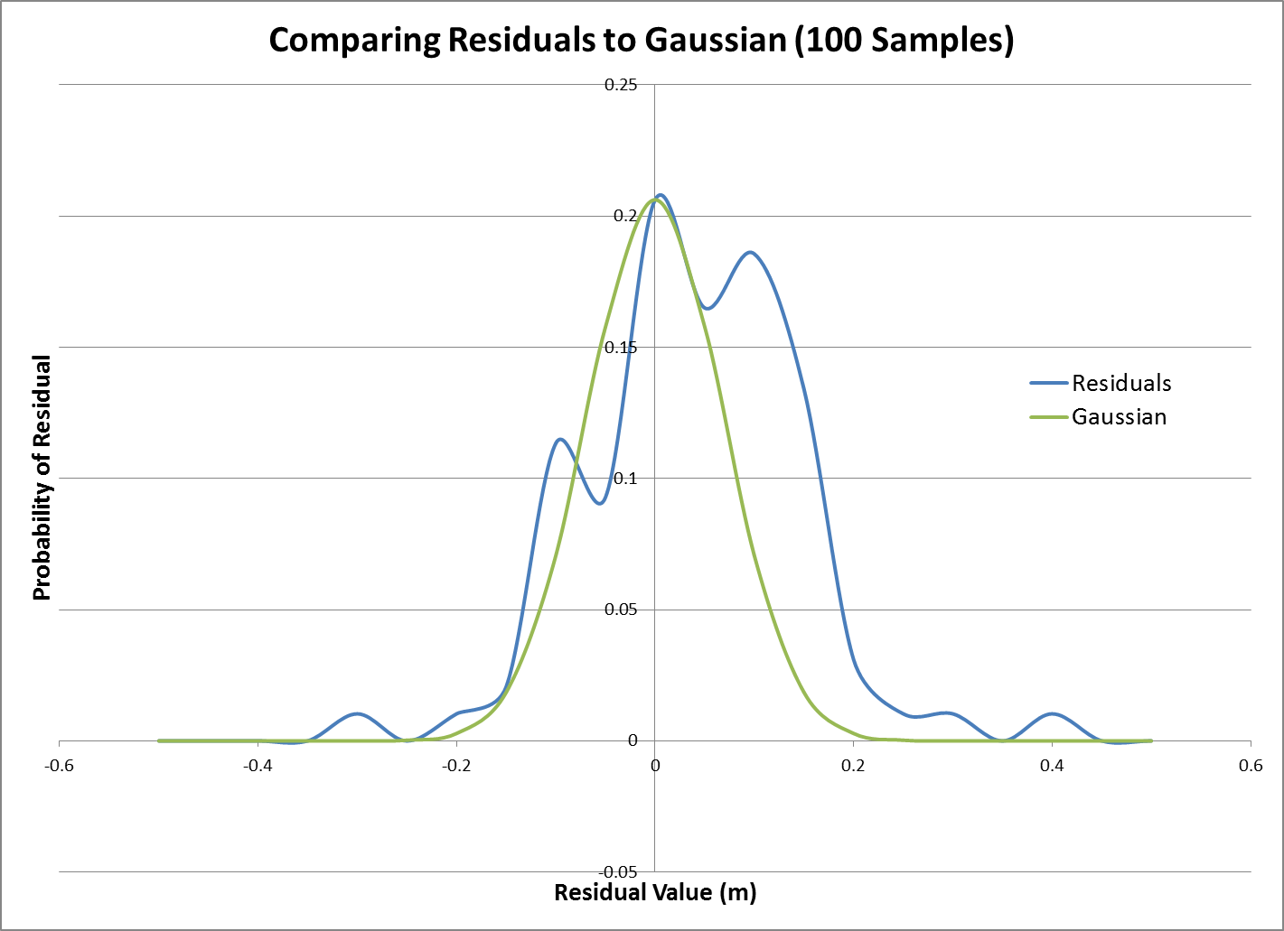
Analyzing Residual Behavior

Slide 15
What if the Model is Wrong?
If the system model is wrong, then the filter can’t be expected to follow the actual system dynamics.
However, it will try.
There’s no need to complicate matters if the simple solution is adequate – test the filter and decide.
If better accuracy is needed, the system and/or measurement model needs to better model the actual system.

Slide 16
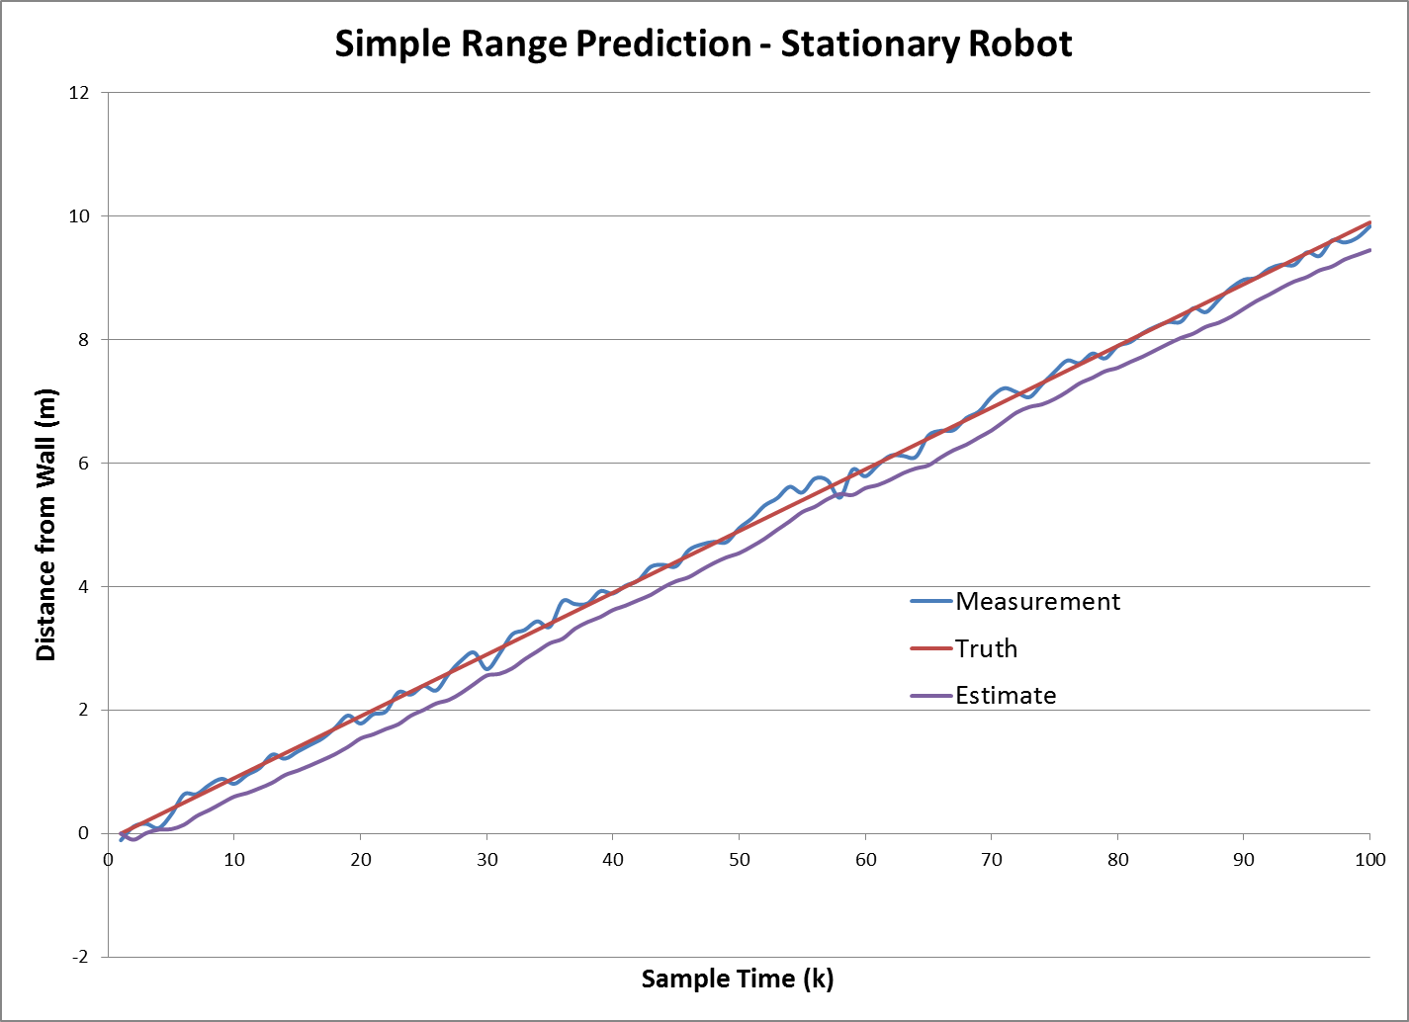
What happens if the Model is Wrong?
In this case, the noisy measurement
is a better estimate of x_{k} than the estimator
with the wrong system model!
We need a better model!

Slide 17
Adding motion to the model
In this case, the actual robot was moving away from the wall at 0.1 m/s, but the model assumed that the robot was stationary.
The filter did remove noise, which is good, but the value that the filter adopted for distance was incorrect.
In fact, the noisy measurement (except at one sample point) was a more accurate estimate of truth than the estimator was!

Slide 18
Can the model be salvaged?
Remember, Keep It Simple (Silly).
There are two “tweakables” in the filter:
The system model
The process noise
Remember, the process noise captures, in part, “unmodeled” errors in the system.
The noise model is easier to change than the system model, so let’s try that first.

Slide 19
Fun with process noise
It’s easy to change the process noise.
If we assume little process noise, then that implies confidence in the model.
Increasing process noise implies less confidence in the model.
So, if the model is “close enough” we may be able to get away with hiding model deficiencies in the process noise model.
Let’s take a look:

Slide 20
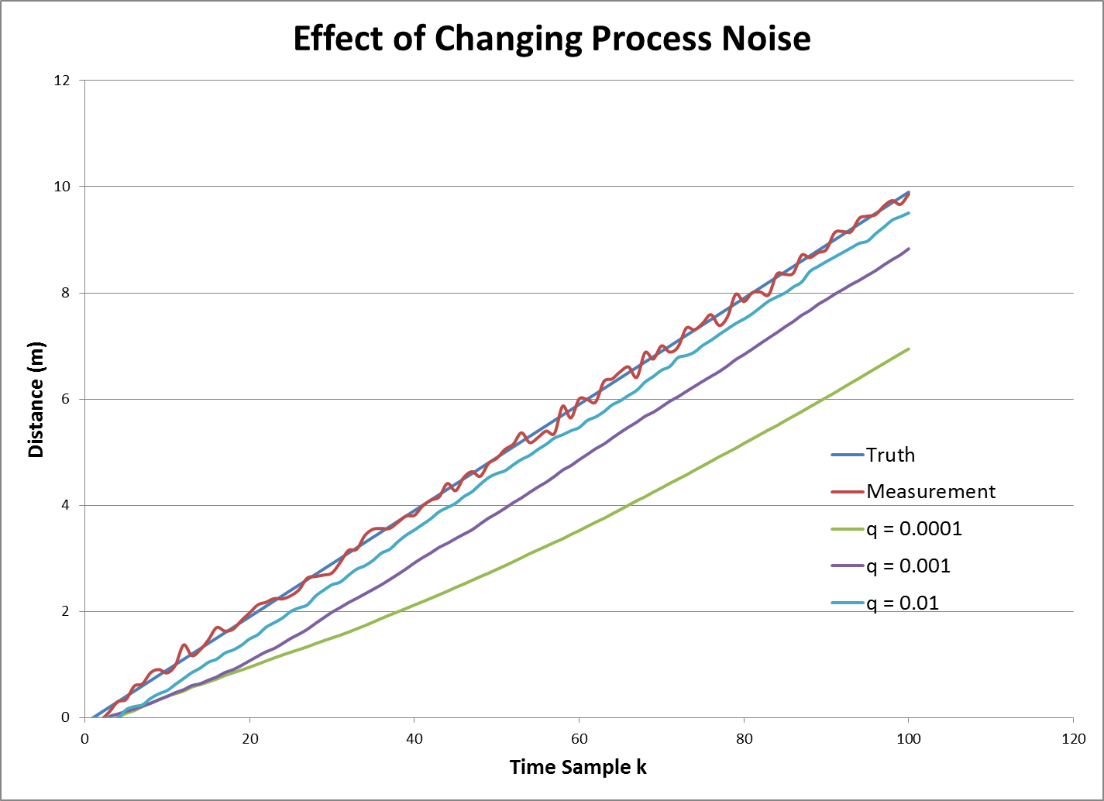
Adjusting the Process Noise

Slide 21
We’re Getting Closer!
As we increase the process noise, we’re able to get the estimate to better track the truth.
Or are we?
In fact, we’re starting to trust the measurements more.
Let’s take a closer look.

Slide 22
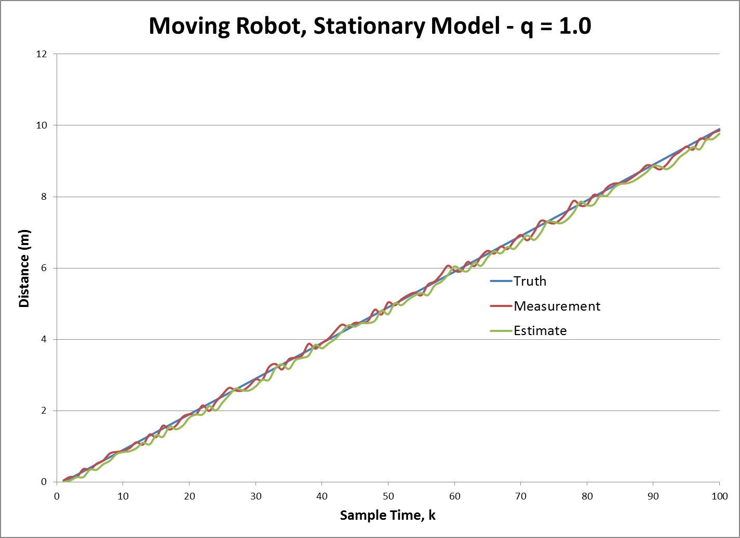
Is q = 1 the solution???

Slide 23
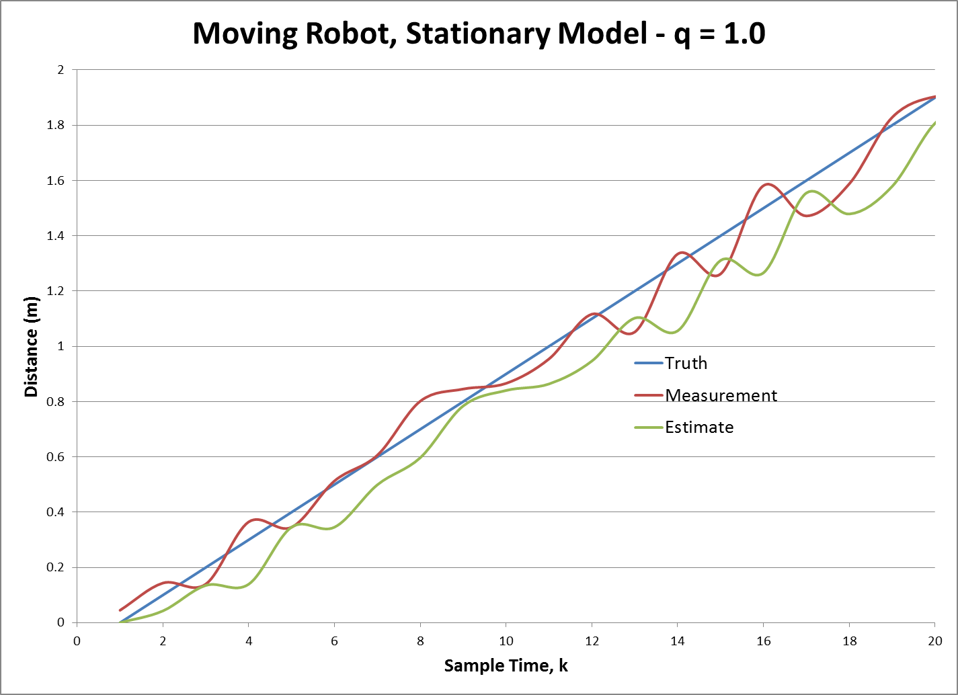
A closer look…
We may be getting closer, but at
this point, we’re no better an
estimate than the measurement!

Slide 24
So tweaking noise isn’t the answer
So, increasing the value for the process noise does make the filter track truth better.
However it also increases the noise in the estimate so much that there’s not much point in having the filter!
Bottom line:
You can compensate for modeling errors by tweaking process noise, but…
A bad model won’t give good estimates.

Slide 25

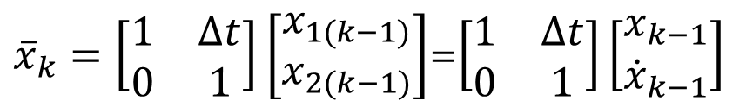
A better model – Back to Step 2!
To fix this, we need to use a more appropriate system model.
In this case, r_{wk} = r_{wk-1} + v_{k-1}t
So now our state model needs to account for both position and velocity – we can still ignore B and u, so:
$${\overline{x}}_{k}=Ax_{k−1}+Bu_{k}$$
${\overline{x}}_{k}=\left[\begin{matrix}1 & ∆t \\ 0 & 1\end{matrix}\right]\left[\begin{matrix}x_{1(k−1)} \\ x_{2(k−1)}\end{matrix}\right]$=$\left[\begin{matrix}1 & ∆t \\ 0 & 1\end{matrix}\right]\left[\begin{matrix}x_{k−1} \\ {\dot{x}}_{k−1}\end{matrix}\right]$

Slide 26
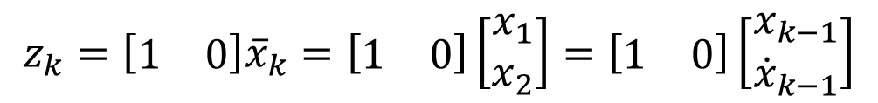

Step 3 – Create a measurement model
Since x is now a vector, we need to adjust our measurement model, H.
We still are only measuring position, so we have:
$$z_{k}=H{\overline{x}}_{k}$$
$$z_{k}=\left[\begin{matrix}1 & 0\end{matrix}\right]{\overline{x}}_{k}=\left[\begin{matrix}1 & 0\end{matrix}\right]\left[\begin{matrix}x_{1} \\ x_{2}\end{matrix}\right]=\left[\begin{matrix}1 & 0\end{matrix}\right]\left[\begin{matrix}x_{k−1} \\ {\dot{x}}_{k−1}\end{matrix}\right]$$

Slide 27
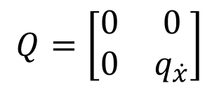
Step 4 – Create a noise model
There has been no change to the range sensor, so that noise model remains the same, R = r.
We have changed the process, so we must also revise our noise process model.
Let’s assume that the noise is corrupting the velocity portion of the state vector.
In continuous time, this means:
$$Q=\left[\begin{matrix}0 & 0 \\ 0 & q_{\dot{x}}\end{matrix}\right]$$

Slide 28

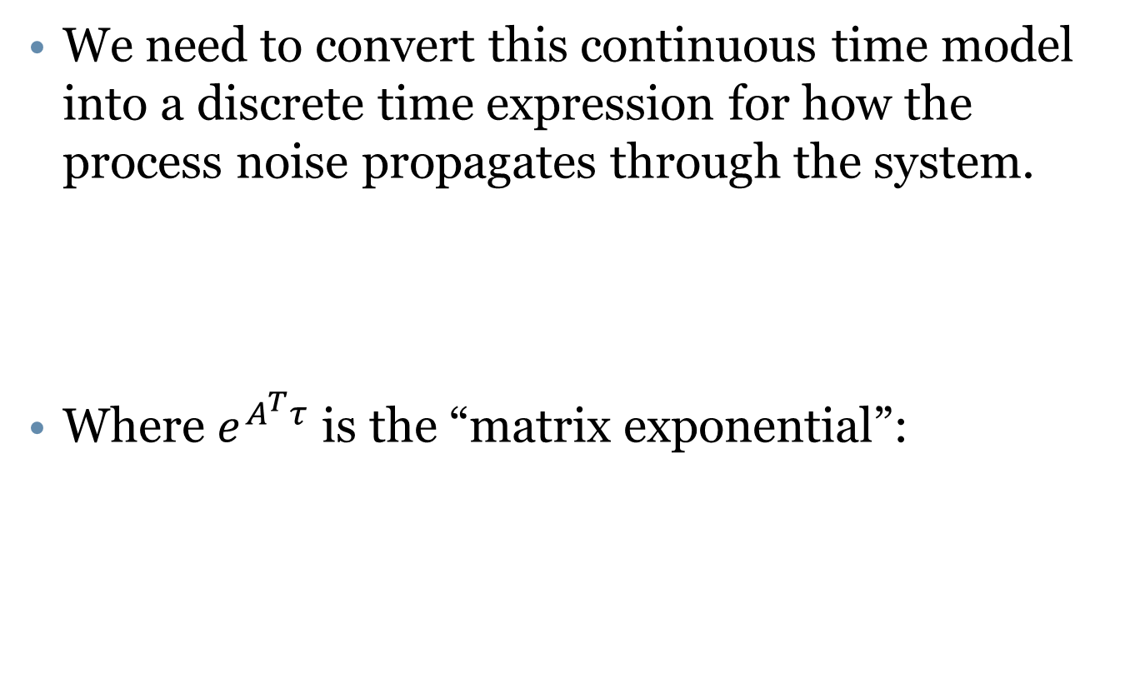

Discrete time process noise
We need to convert this continuous time model into a discrete time expression for how the process noise propagates through the system.
Where $e^{A^{T}τ}$ is the “matrix exponential”:
$$Q\left(∆t\right)=\int_{0}^{∆t}{e^{Aτ}Qe^{A^{T}τ}dτ}$$
$$e^{A^{T}τ}=\sum_{n=0}^{∞}{\frac{τ^{n}A^{n}}{n!}}$$
See: http://www.millersville.edu/~bikenaga/linear-algebra/matrix-exponential/matrix-exponential.html

Slide 29
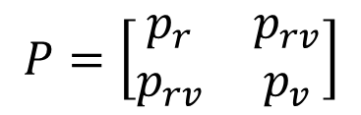

Discrete time process noise
Solving the matrix exponential provides our process noise model:
In addition, the error covariance is now a matrix:
$$Q=\left[\begin{matrix}\frac{∆t^{3}q_{v}}{3} & \frac{∆t^{2}q_{v}}{2} \\ \frac{∆t^{2}q_{v}}{2} & ∆tq_{v}\end{matrix}\right]$$
$$P=\left[\begin{matrix}p_{r} & p_{rv} \\ p_{rv} & p_{v}\end{matrix}\right]$$

Slide 30


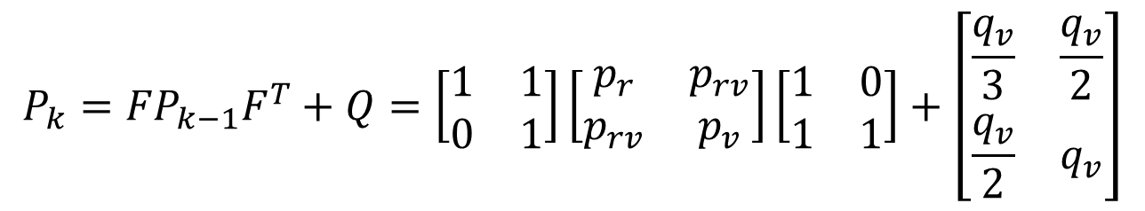
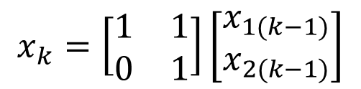
Step 5 – Test the Filter
If we assume that Δt = 1, then we have:
The prediction equations are:
$$Q=\left[\begin{matrix}\frac{q_{v}}{3} & \frac{q_{v}}{2} \\ \frac{q_{v}}{2} & q_{v}\end{matrix}\right]$$
$$F=\left[\begin{matrix}1 & 1 \\ 0 & 1\end{matrix}\right]$$
$$x_{k}=\left[\begin{matrix}1 & 1 \\ 0 & 1\end{matrix}\right]\left[\begin{matrix}x_{1(k−1)} \\ x_{2(k−1)}\end{matrix}\right]$$
$$P_{k}={FP}_{k−1}F^{T}+Q=\left[\begin{matrix}1 & 1 \\ 0 & 1\end{matrix}\right]\left[\begin{matrix}p_{r} & p_{rv} \\ p_{rv} & p_{v}\end{matrix}\right]\left[\begin{matrix}1 & 0 \\ 1 & 1\end{matrix}\right]+\left[\begin{matrix}\frac{q_{v}}{3} & \frac{q_{v}}{2} \\ \frac{q_{v}}{2} & q_{v}\end{matrix}\right]$$

Slide 31
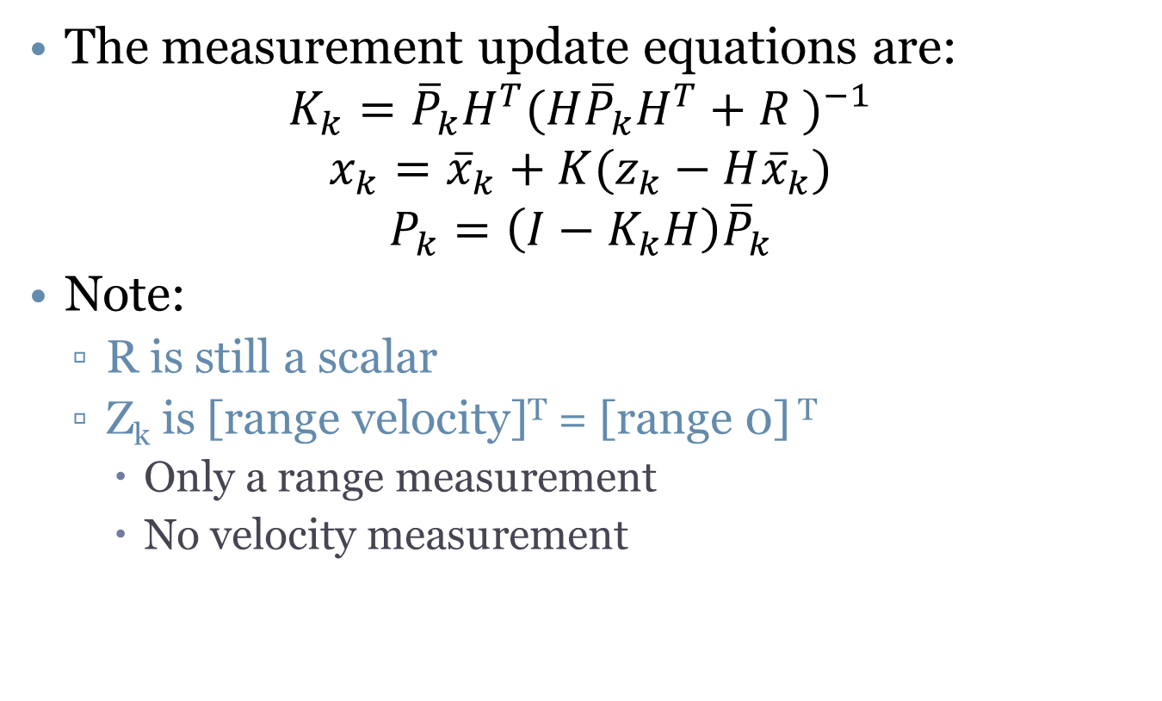
Test the filter
The measurement update equations are:
$$K_{k}={\overline{P}}_{k}H^{T}{(H{\overline{P}}_{k}H^{T}+R )}^{−1}$$
$$x_{k}={\overline{x}}_{k}+K(z_{k}−H{\overline{x}}_{k})$$
$$P_{k}=\left(I−K_{k}H\right){\overline{P}}_{k}$$
Note:
R is still a scalar
Z_{k} is [range velocity]^{T} = [range 0] ^{T}
Only a range measurement
No velocity measurement

Slide 32

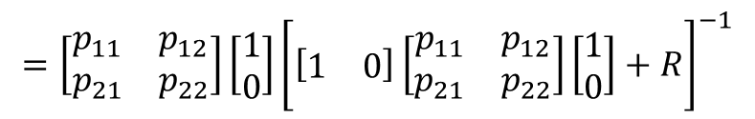
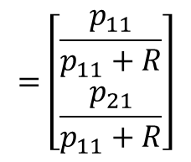
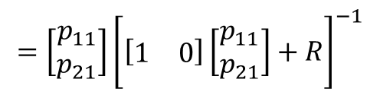
Look at the gain update equation
Given our measurement matrix H and measurement covariance R, we have:
$$K_{k}={\overline{P}}_{k}H^{T}{(H{\overline{P}}_{k}H^{T}+R )}^{−1}$$
$$=\left[\begin{matrix}p_{11} & p_{12} \\ p_{21} & p_{22}\end{matrix}\right]\left[\begin{matrix}1 \\ 0\end{matrix}\right]{\left[\left[\begin{matrix}1 & 0\end{matrix}\right]\left[\begin{matrix}p_{11} & p_{12} \\ p_{21} & p_{22}\end{matrix}\right]\left[\begin{matrix}1 \\ 0\end{matrix}\right]+R\right]}^{−1}$$
$$=\left[\begin{matrix}p_{11} \\ p_{21}\end{matrix}\right]{\left[\left[\begin{matrix}1 & 0\end{matrix}\right]\left[\begin{matrix}p_{11} \\ p_{21}\end{matrix}\right]+R\right]}^{−1}$$
$$=\left[\begin{matrix}\frac{p_{11}}{p_{11}+R} \\ \frac{p_{21}}{p_{11}+R}\end{matrix}\right]$$

Slide 33

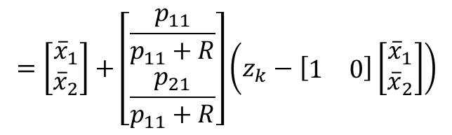
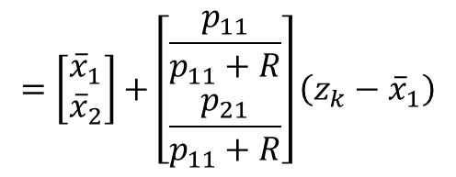
Look at the state update equation
Now we have the Kalman Gain, measurement matrix H and measurement z. The state update is:
$$x_{k}={\overline{x}}_{k}+K(z_{k}−H{\overline{x}}_{k})$$
$$=\left[\begin{matrix}{\overline{x}}_{1} \\ {\overline{x}}_{2}\end{matrix}\right]+\left[\begin{matrix}\frac{p_{11}}{p_{11}+R} \\ \frac{p_{21}}{p_{11}+R}\end{matrix}\right]\left(z_{k}−\left[\begin{matrix}1 & 0\end{matrix}\right]\left[\begin{matrix}{\overline{x}}_{1} \\ {\overline{x}}_{2}\end{matrix}\right]\right)$$
$$=\left[\begin{matrix}{\overline{x}}_{1} \\ {\overline{x}}_{2}\end{matrix}\right]+\left[\begin{matrix}\frac{p_{11}}{p_{11}+R} \\ \frac{p_{21}}{p_{11}+R}\end{matrix}\right]\left(z_{k}−{\overline{x}}_{1}\right)$$

Slide 34
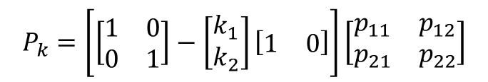

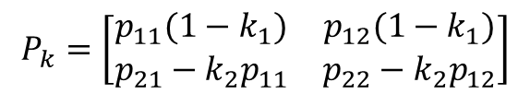
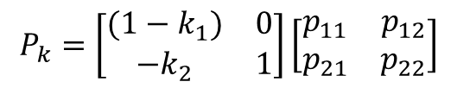
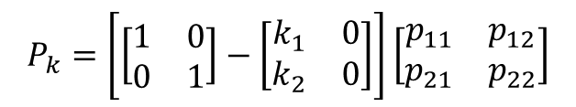
Look at the error covariance update
Knowing K and H, we now need to update P:
$$P_{k}=\left(I−K_{k}H\right){\overline{P}}_{k}$$
$$P_{k}=\left[\left[\begin{matrix}1 & 0 \\ 0 & 1\end{matrix}\right]−\left[\begin{matrix}k_{1} \\ k_{2}\end{matrix}\right]\left[\begin{matrix}1 & 0\end{matrix}\right]\right]\left[\begin{matrix}p_{11} & p_{12} \\ p_{21} & p_{22}\end{matrix}\right]$$
$$P_{k}=\left[\left[\begin{matrix}1 & 0 \\ 0 & 1\end{matrix}\right]−\left[\begin{matrix}k_{1} & 0 \\ k_{2} & 0\end{matrix}\right]\right]\left[\begin{matrix}p_{11} & p_{12} \\ p_{21} & p_{22}\end{matrix}\right]$$
$$P_{k}=\left[\begin{matrix}(1−k_{1}) & 0 \\ {−k}_{2} & 1\end{matrix}\right]\left[\begin{matrix}p_{11} & p_{12} \\ p_{21} & p_{22}\end{matrix}\right]$$
$$P_{k}=\left[\begin{matrix}p_{11}(1−k_{1}) & p_{12}(1−k_{1}) \\ {p_{21}−k}_{2}p_{11} & {p_{22}−k}_{2}p_{12}\end{matrix}\right]$$

Slide 35
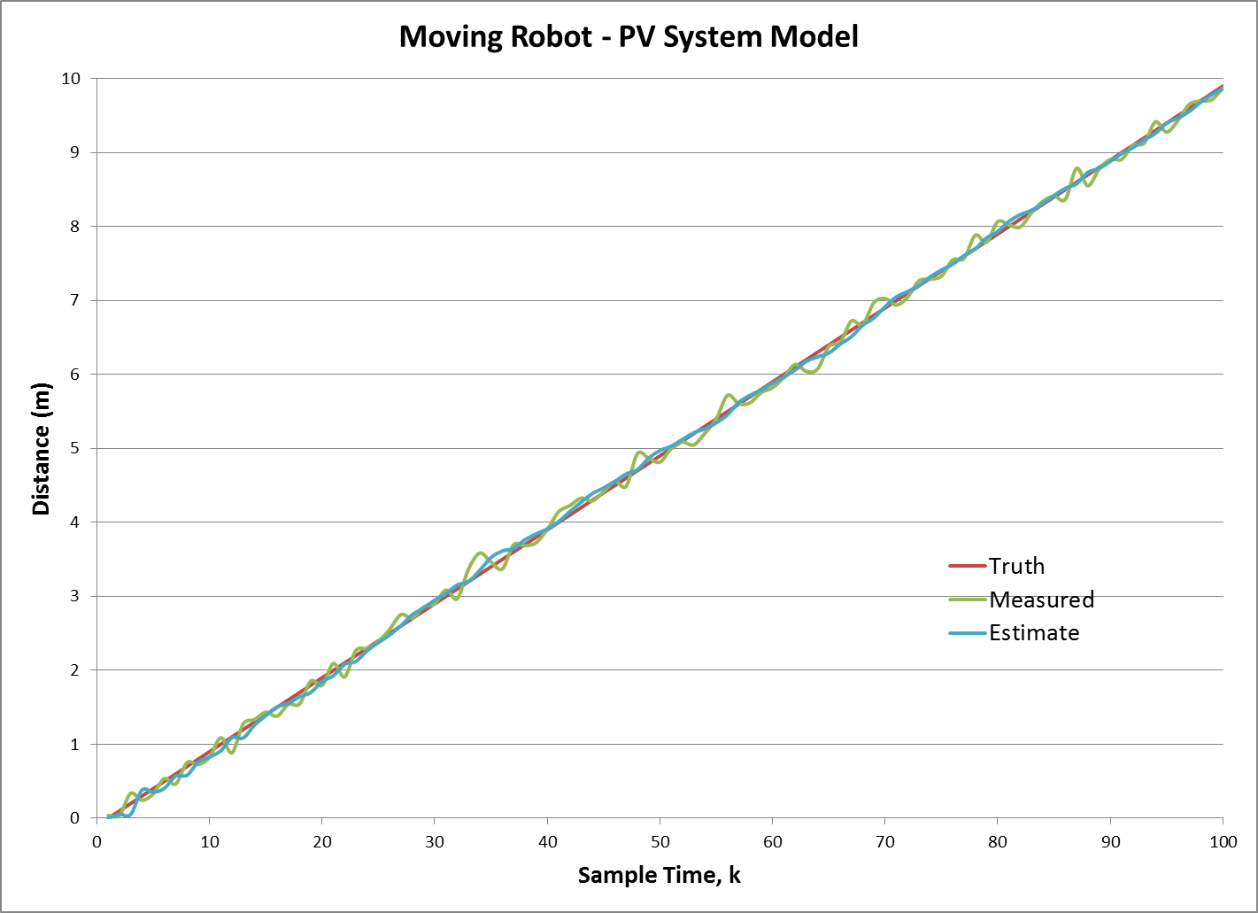
So, does all the math work???

Slide 36
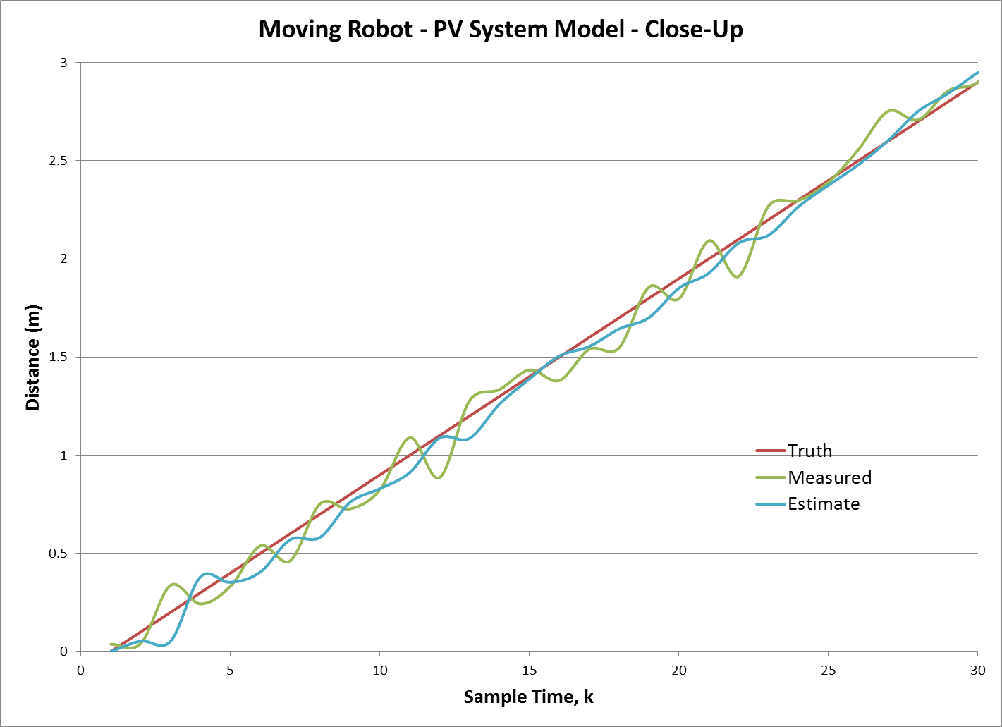
Using the right model matters!

Slide 37
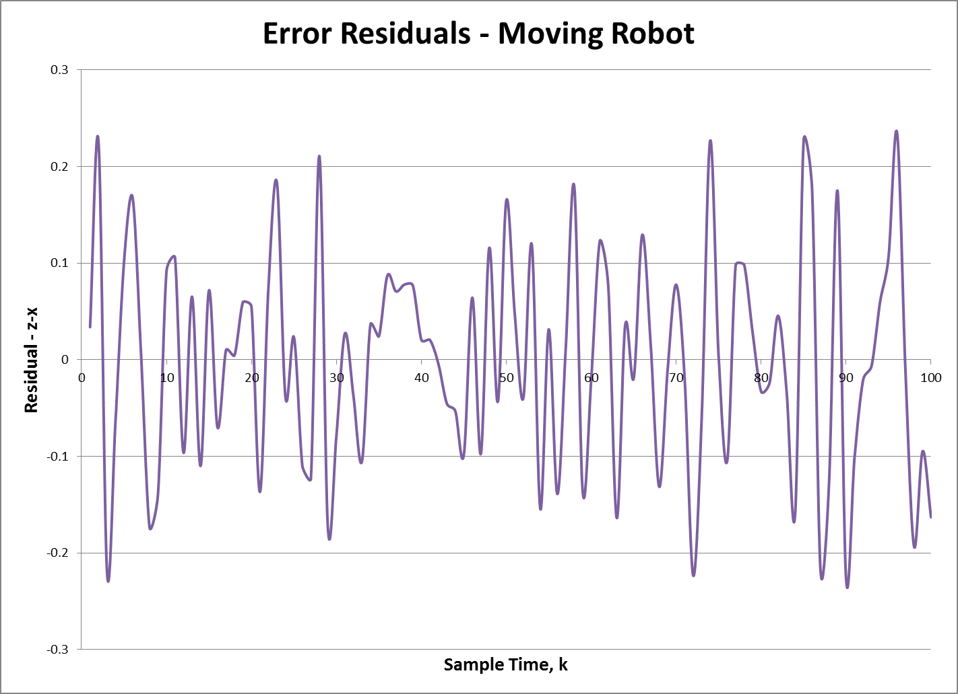
Error residuals

Slide 38
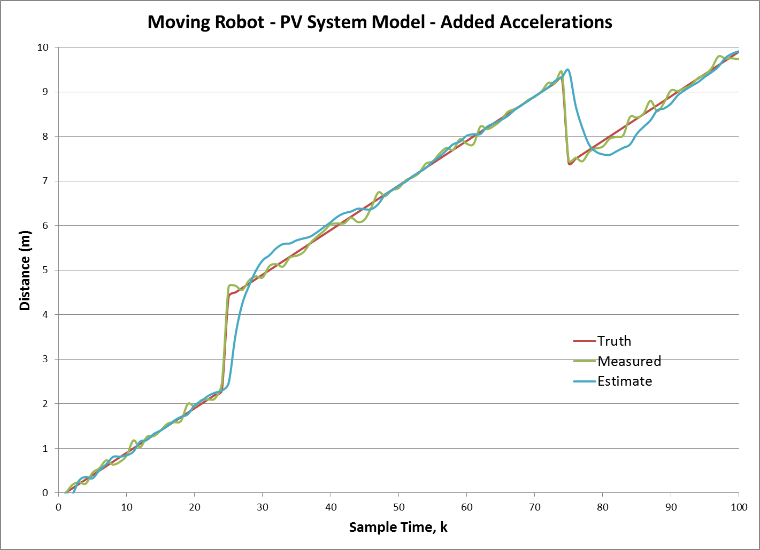
And if we start violating model assumptions!

